Slide 1
Joint Replication-Migration-based Routing in Delay Tolerant Networks
Yunsheng Wang and Jie Wu
Temple University
Zhen Jiang Feng Li
West Chester Unveristy IUPUI

Slide 2
Outline
Background
Motivation
Replication-Migration-based Routing
Simulation and evaluation
Conclusion

Slide 3
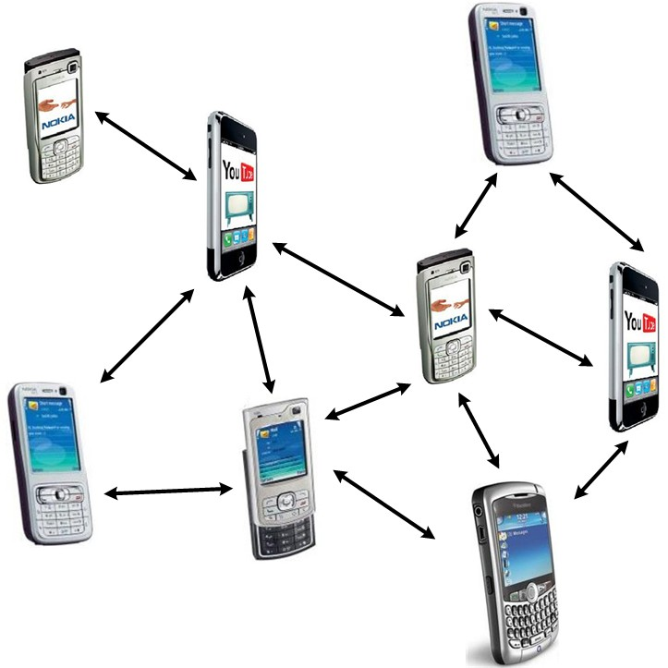
Delay Tolerant Networks (DTNs)
Occasionally connected networks
Examples of DTNs
Deep space communication
Wildlife monitoring
Vehicular communication
Social contact networks
Efficient routing is still a main challenge!

Slide 4
Motivation 1
Existing DTN routing:
Neighborhood Information (1-hop)
Limited local view
We use 2-hop information as the forwarding metric for routing guidance.

Slide 5
Motivation 2
Limited buffer space
Resource Congestion
Message Discard
Our approach:
Migrate the message to an alternative node when the available buffer space is below a threshold.

Slide 6
Replication-Migration-based Routing
Replication-migration-based routing is based on prioritizing the schedule of the messages being transmitted to other nodes when there are multiple messages in the buffer based on message hop-count.
Message Replication
Message Migration

Slide 7
Message Replication
Replication message selection
Replication node selection

Slide 8
Replication message selection
Hop-count (H_{m}): the number of forwardings that the message m has made
Select the smallest hop-count message m (H_{m}) as the candidate replication message
Hop-count threshold (T_{h}): control the message replication speed
H_{m} < T_{h} (the message is new), replicate without node selection

Slide 9
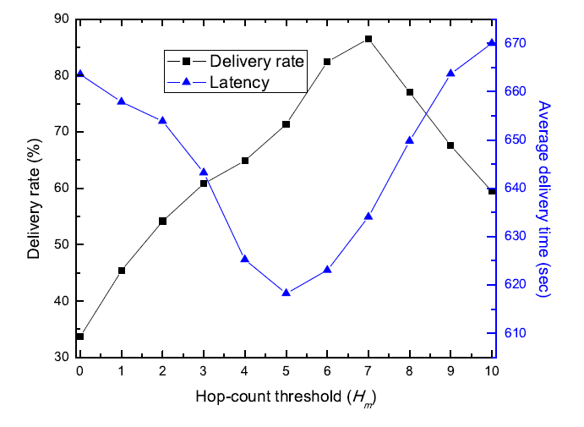
Hop-count threshold

Slide 10
Replication node selection
2-hop activity level: the combination of its own encounter history and its neighbors’ encounter histories (number of contacts)
Replicate the message to a higher 2-hop activity level node

Slide 11
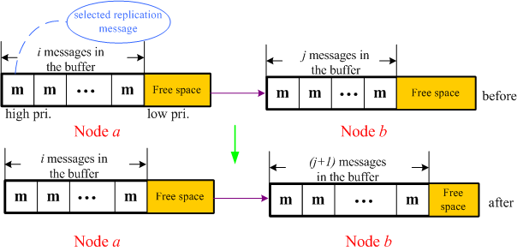
An illustration of message replication

Slide 12
Message Migration
When the available buffer space is below a threshold, the node will migrate a message to an alternative node that has enough buffer space early on.
Migration message selection: select the largest hop-count message to migrate
Migration node selection: migrate the message to an alternative node with enough buffer space

Slide 13
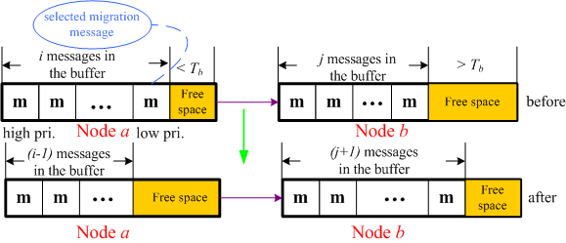
An illustration of message migration

Slide 14
Simulation
Synthetic trace: 20 nodes follow random waypoint mobility model
Real trace: Intel trace

Slide 15
Evaluation metrics
Delivery rate
Number of forwardings
Latency
Number of lost messages

Slide 16
Simulation Scenarios
Comparisons between joint replication-migration scheme and the replication scheme in different buffer space thresholds.
Comparisons between joint replication-migration scheme and the replication scheme in different hop-count thresholds.
Comparisons between using 2-hop information and 1-hop information schemes

Slide 17
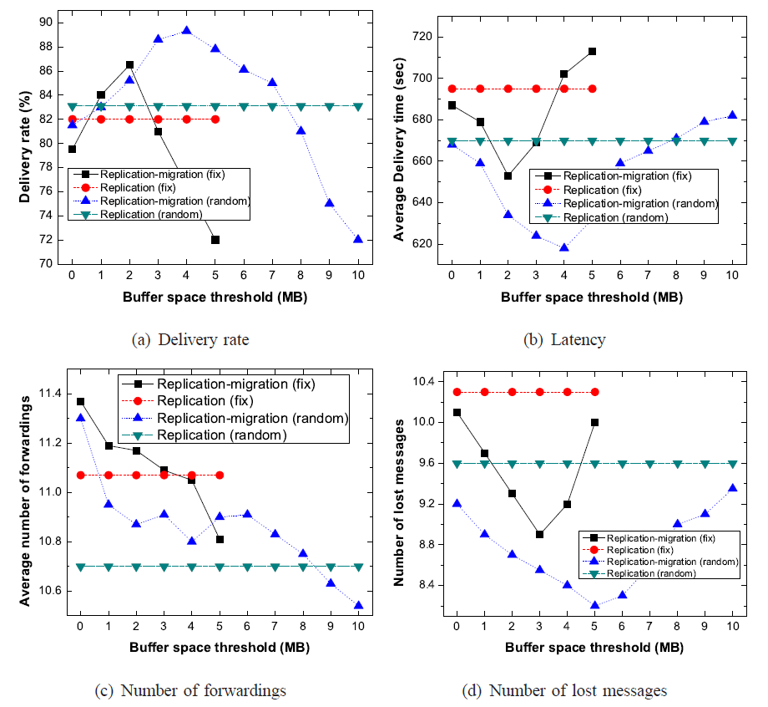
Different buffer space thresholds
Synthetic

Slide 18
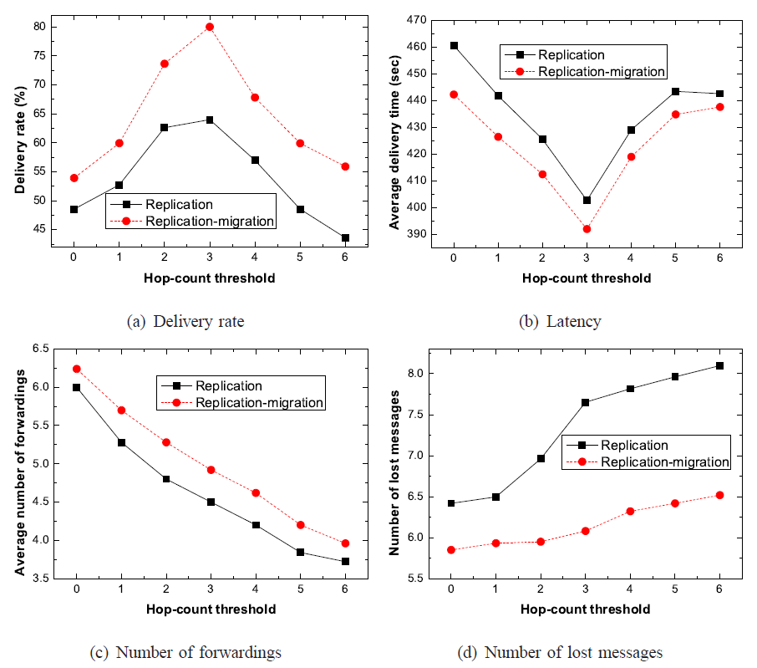
Different hop-count thresholds
Real

Slide 19
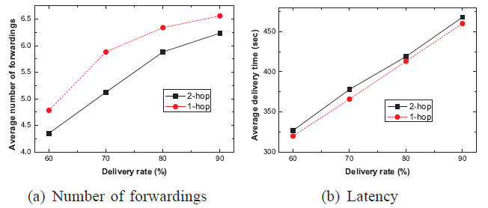
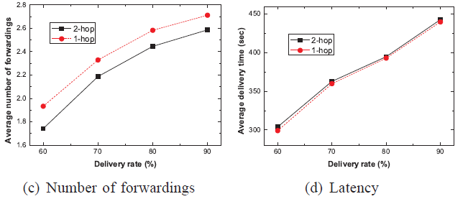
Different buffer space thresholds
Synthetic
Real

Slide 20
Conclusion
A Joint Replication-Migration-based Routing
Message Replication
Message Migration
Implementation and Simulation

Slide 21
Questions ?

